Slide 1
Political Subreddit Classifier
Zach Tretter
GA DSI Project 3
24 Apr 2020
This analysis is intended to be strictly apolitical

Slide 2
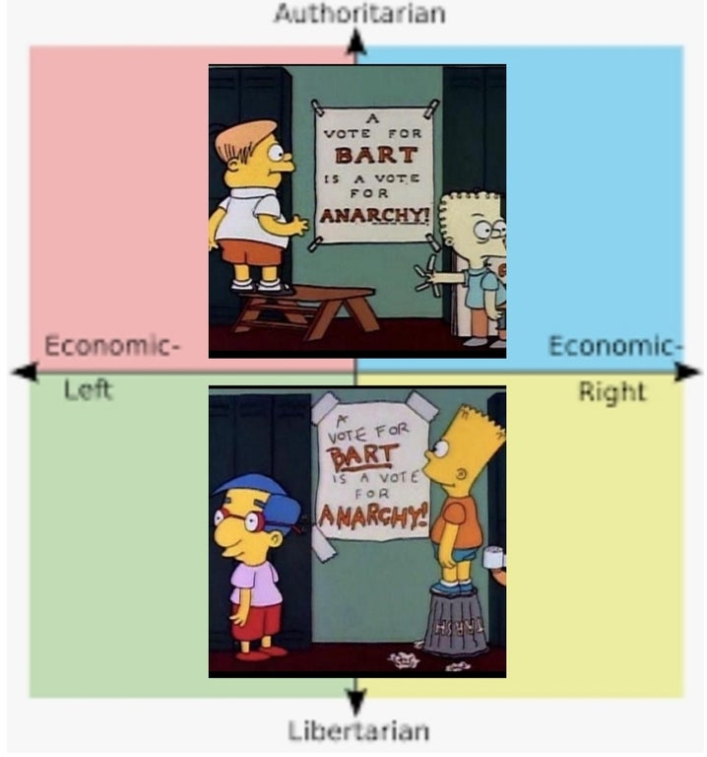
Data Science Problem
Problem Statement - Explore the power of binary classification models to differentiate between two subreddits
Subreddits of Interest
r/conservative
r/libertarian
Why these subreddits?
Both advertise themselves as “the place for __”
Enough overlap to be interesting
but still enough to be distinguishable
Comparable size (~350K subscribers)
Other political subreddits have insane post volume
(Image not related to project)

Slide 3
Data Gathering
Pull 100K submissions from each subreddit
Goes from April 2020 to Apr 2019 for r/conservative
Goes from April 2020 to Aug 2018 for r/libertarian
Examine submissions with at least 10 upvotes
Upvoted content reflects what is ‘representative’ of a subreddit
2/3 of all submissions never progress beyond 1 upvote
Take a random sample of 5K from each to maintain balanced classes
Independent variable is submission titles

Slide 4
Text Pre-Processing
Remove subreddit names from text input
Submissions are sometimes tagged [Conservatives Only]
Discussion threads may have subreddit title in name
Keep numbers
Numbers like ‘2020’ or ’16’ have strong political meaning
Limitations of approach
Image posts (e.g. memes)
Article links
Variations in Names – “President Trump”, “Trump”, “POTUS”, “Donald Trump”, etc

Slide 5
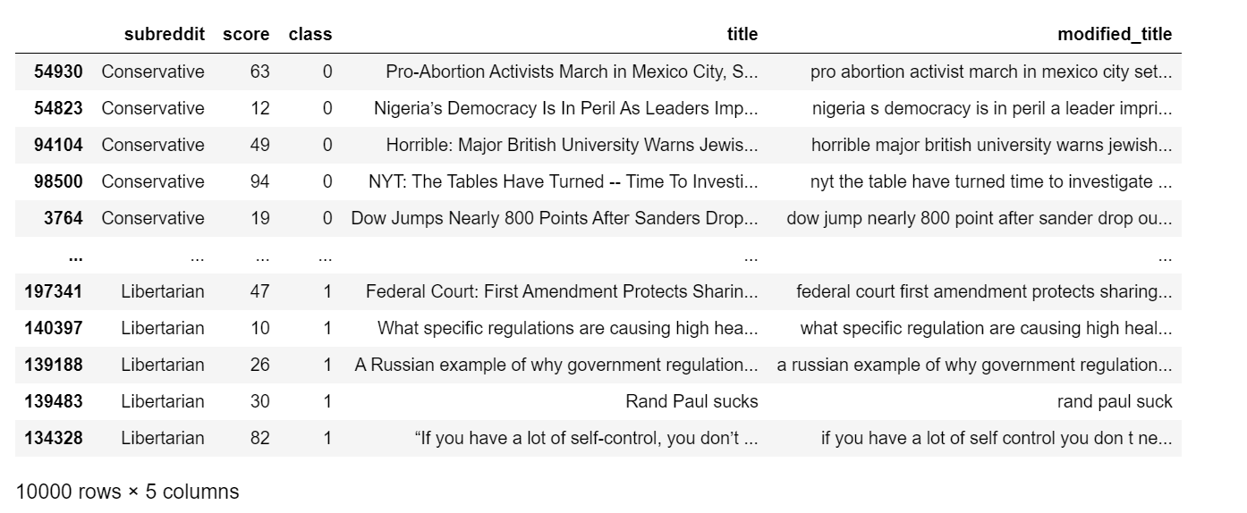
Summary of Input Data

Slide 6
Overview of Model Performances
Model Structure |  | Model Performance |  | Classifier Parameters Selected by Grid Search
Classifier | Transformer | Train Score | Test Score | max df | max features | min df | ngram | Stop Words
Logistic Regression | CVEC | 0.80 | 0.72 | 0.5 | 2000 | 0.0 | [1,2] | English
Logistic Regression | TFIDF | 0.82 | 0.73 | 0.5 | 2000 | 0.0 | [1,1] | English
Multinomial Bayes | CVEC | 0.76 | 0.71 | 0.5 | 2000 | 0.0 | [1,1] | None
Multinomial Bayes | TFIDF | 0.78 | 0.72 | 0.5 | 2000 | 0.0 | [1,1] | None
Support Vector | CVEC | 0.92 | 0.71 | 0.5 | 2000 | 0.0 | [1,2] | English
Support Vector | TFIDF | 0.94 | 0.72 | 0.5 | 2000 | 0.0 | [1,1] | None
Random Forest | CVEC | 0.83 | 0.68 | 0.5 | 1000 | 0.0 | [1,1] | None
Random Forest | TFIDF | 0.82 | 0.67 | 0.5 | 2000 | 1.0 | [1,2] | English
Uniformity of Model Performance on Test Data

Slide 7
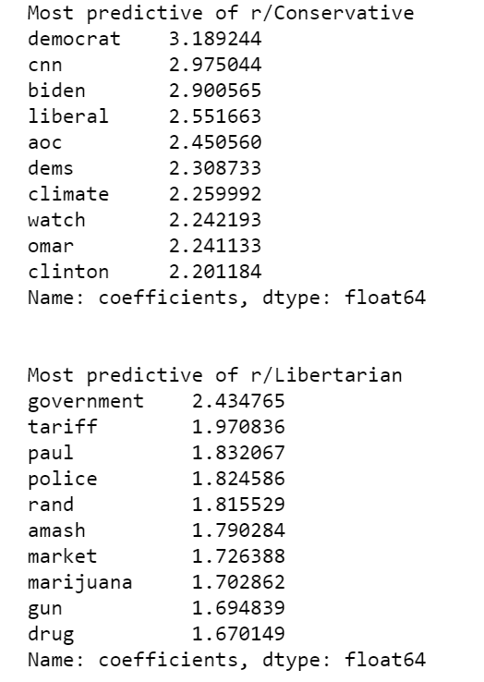
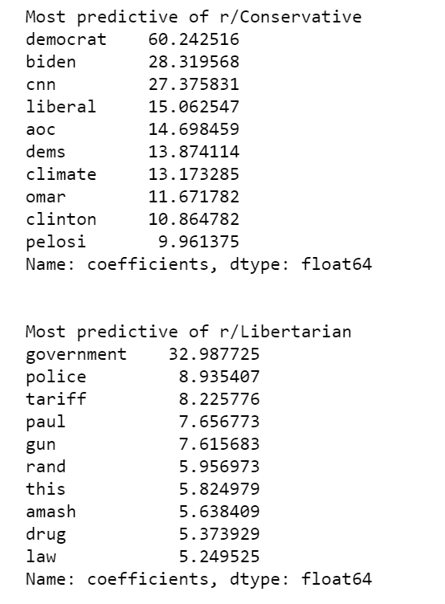
Aside – Most Predictive Words Logistic Regression Coefficients
Count Vectorizer*
*gridsearch yielded C=0.1
hence the low coefficients
TFIDF

Slide 8
Findings and Conclusions
All Models performed similarly on test data (~70%)
SVCs and Random Forests particularly suffered from overfit
TFIDF performed marginally better than Count Vectorizer for Logistic/Bayes/SVC
Reverse performance with Random Forest
Consistently more inaccurate predictions of conservative than of libertarian
Findings from Grid Searches
Models almost always select for more features
Max_df always selected to be 1
min_df almost always selected to be zero
No clear trend for length of n-grams nor inclusion of stopwords
These models show we can be ~40% more accurate than a random guess!

